Slide 1


DEPARTMENT OF AUTOMOBILE ENGINEERING
MIT CAMPUS, ANNA UNIVERSITY, CHENNAI – 44
FIRST REVIEW – PHASE 2
S.No | Name | Register Number
1 | NIROSHINI. K | 2019502032
2 | AKILAN. S | 2019502509
3 | DHINESH BABU. R | 2019502517
4 | HARI VIGNESH. N S | 2019502523
GUIDE:
Dr. A.Sangeet Sahaya Jeyangel,
Teaching Fellow,
Department of Automobile Engineering,
MIT campus, Anna university

Slide 2
TITLE
EXPERIMENTAL ANALYSIS OF PERFORMANCE,COMBUSTION AND EMISSION CHARACTERISTICS OF SINGLE CYLINDER DIESEL ENGINE USING BIODIESEL (DIESEL-TURPENTINE BLEND) WITH HYDROGEN INDUCTION.

Slide 3
INTRODUCTION
Entire worldwide, fossil reserves are getting scantier and progressively exorbitant with time.
Moreover, constant dependency on them leads to the frightening plight of global warming. Higher fuel prices and limited natural resources have forced the researchers to pursue research on green alternative fuels.
The use of biodiesel obtained from plants in internal combustion engine is finding its place to replace the use of conventional fuel. In our research, the performance, combustion and emission characteristics of diesel engine fueled with biodiesel (diesel-turpentine blend) with hydrogen induction.

Slide 4
LITERATURE SURVEY
SI NO | JOURNAL NAME | YEAR | TOPIC | AUTHORS | INFERENCE
1 | Elsevier | 2019 | Experimental study on the effect of cetane improver with turpentine oil on CI engine characteristics | A.K.Jeevanantham, D.Madhusudan reddy,B.Ashok, Aman kumar | A novel cetane improver called SC5D is added with 20% blend of turpentine with diesel. For higher Nox emission condition,10% of EGR is applied. At this condition, unburned HC and smoke emissions are remarkably lower.
2 | Researchgate | 2017 | A review on novel bio-fuel from turpentine oil | Mehmet Hakki Alma, Tufan Salan | At 40% blend of turpentine oil with diesel mixture shows 2.5% increase in BTE than the diesel. nearly 50% smoke was reduced but a little shoot and co was found.

Slide 5
SI NO | JOURNAL NAME | YEAR | TOPIC | AUTHORS | INFERENCE
3 | Elsevier | 2018 | Influences of dual bio-fuel (Jatropha biodiesel and turpentine oil) on single cylinder variable compression ratio diesel engine | Pankaj Dubey, Rajesh Gupta | Experiments have been accompanied at CR of 15.5:1,17:1,18.5:1 and 20:1. Biofuel blend (JBT50) resulted at full load and CR 20:1,there was 2.17% increase inBTEand13.04%,17.5%,4.21% and 30.8% decrease in CO,HC, NOx and smoke and 11.04% increase in CO respectively.
4 | Elsevier | 2010 | Performance and exhaust emission of turpentine oil powered direct injection diesel engine | B. Prem Anand, C.G. Saravanan, C. Ananda Srinivasan | 30% of turpentine oil blend with diesel produce high brake power and net heat release rate with a net reduction in CO,HC,Nox,smoke and particulate matter. 40% and 50% blends produce lower brake power.

Slide 6
SI NO | JOURNAL NAME | YEAR | TOPIC | AUTHORS | INFERENCE
5 | Elsevier | 2019 | Control of backfire and NOx emission reduction in a hydrogen fueled multi-cylinder spark ignition engine using cooled EGR and water injection strategies. | Vipin dhyani,K.A. Subramanian. | The experimental test was conducted on a engine with varied EGR rate (0% - 28% volume) and water to hydrogen ratio (0-9.25) at 15kW load It was found that at 25% EGR,there was 57% reduction in Nox,with WHR of 7.5, the Nox emission was reduced by 97% without affecting the efficiency.
6 | Elsevier | 2011 | Hydrogen effects on Nox emissions and brake thermal efficiency in a diesel engine under low-temperature and heavy –EGR ondition. | Buomsik shin,Youngsoo cho,Daeha han,Soonho song | The experiment was observed over a constant EGR ratios of 2,16 and 31%. The Nox reduction due to hydrogen addition increased at higher EGR ratio. At 31% EGR ratio,the Nox was lowered by 25% and a slight increase in brake thermal efficiency.

Slide 7
RESEARCH GAP
A review on novel bio-fuel from turpentine oil by Mehmet Hakki Alma, Tufan Salan (2017) - has discussed about the use of 40% of turpentine oil blend with diesel in diesel engine.
Influences of dual bio-fuel (Jatropha biodiesel and turpentine oil) on single cylinder variable compression ratio diesel engine by Pankaj Dubey, Rajesh Gupta (2018) – has discussed about the use of jatropha and turpentine oil blend in single cylinder diesel engine.
But so far no one has explored the arena of using hydrogen induction with turpentine blend with diesel biodiesel and analyzing the performance, combustion and emission characteristics of single cylinder ci engine.

Slide 8
AIM & OBJECTIVE
To experimentally test the performance , combustion , emissions characteristics of single cylinder diesel engine using biodiesel.
Objective is to compare the characteristics of biodiesel blends(diesel-turpentine) and the same with hydrogen induction for the best two blends (B20 and B30).

Slide 9
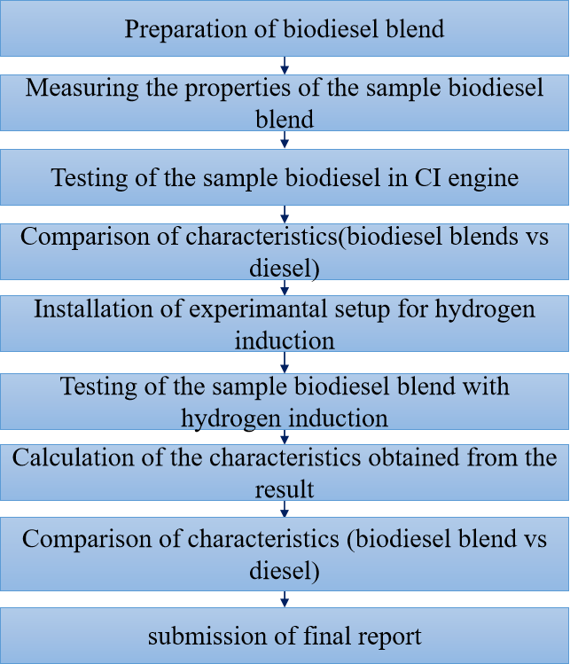
METHODOLOGY

Slide 10
WHY TURPENTINE OIL?
Turpentine oil is physically a yellowish, opaque, odorous and water-immiscible liquid when it is chemically flammable,volatile and combustible.
Turpentine oil is mixture of α- and β- pinenes(30% and 60% respectively) and other isometric terpenes.
Turpentine oil is extracted from the resin of pine tree(genus pinus) saps and leaves.
Turpentine oil having low viscosity and lower carbon resides and environmentally friendly due to its low Sulphur content Also, the properties of turpentine oil are similar with diesel.

Slide 11
PROPERTIES OF FUEL
BLEND | DENSITY(kg/m³) | KINEMATIC VISCOSITY ( m²/s) | FLASH POINT (°c) | FIRE POINT (°c)
DIESEL | 0.827 | 13.28 | 47 | 54
B20 | 0.831 | 14.567 | 49 | 55
B30 | 0.835 | 14.147 | 52 | 57
B40 | 0.839 | 13.360 | 55 | 60
B50 | 0.844 | 13.055 | 57 | 62
TURPENTINE | 0.845 | 10.870 | 53 | 58

Slide 12
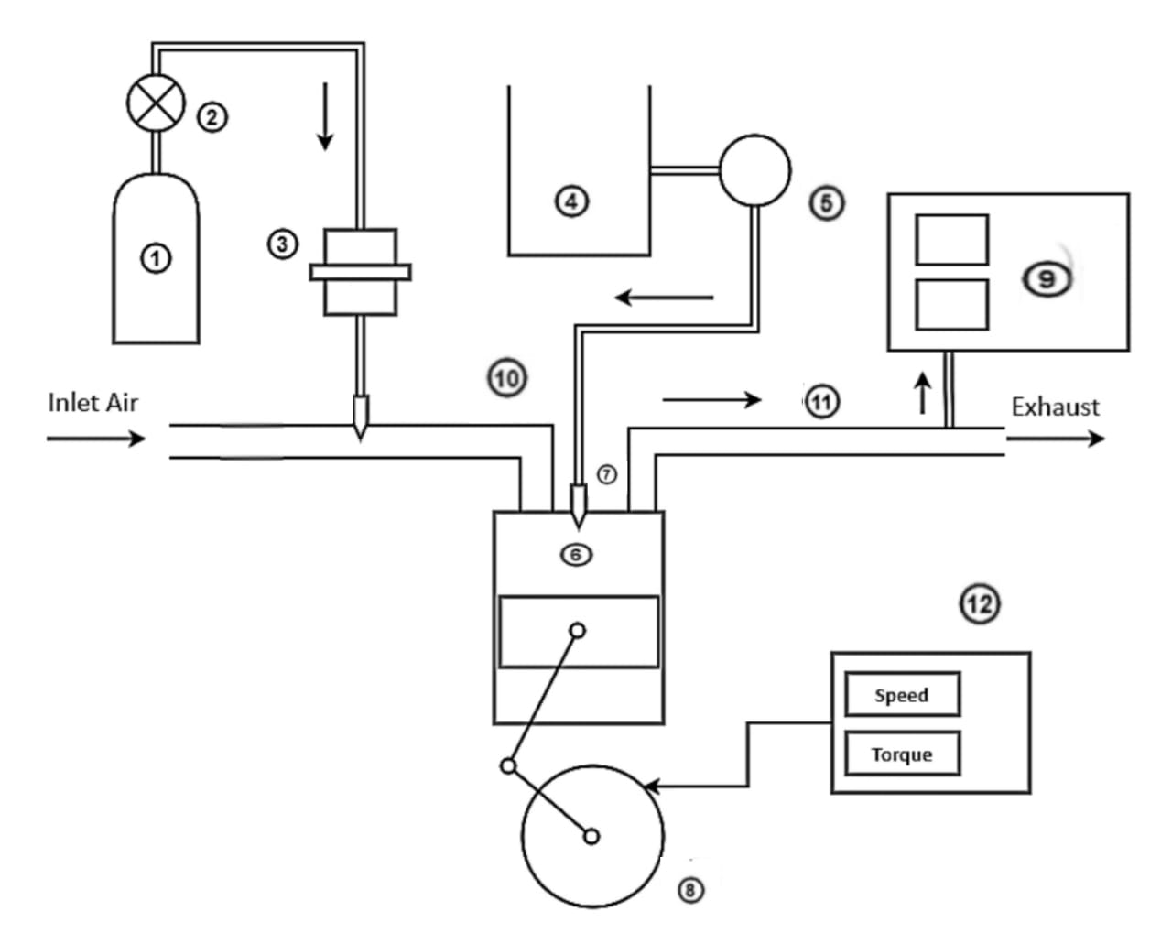
ENGINE LAYOUT
① - Hydrogen Storage Tank
② - Pressure Regulator
③ - Flame Arrestor
④ - biodiesel-Diesel blend tank
⑤ - Fuel Pump
⑥ - Diesel Engine
⑦ - Fuel Injector
⑧ - Crank Wheel
⑨ - Exhaust Gas Analyzer
⑩ - Inlet Manifold
⑪ - Exhaust Manifold
⑫ - Dynamometer

Slide 13
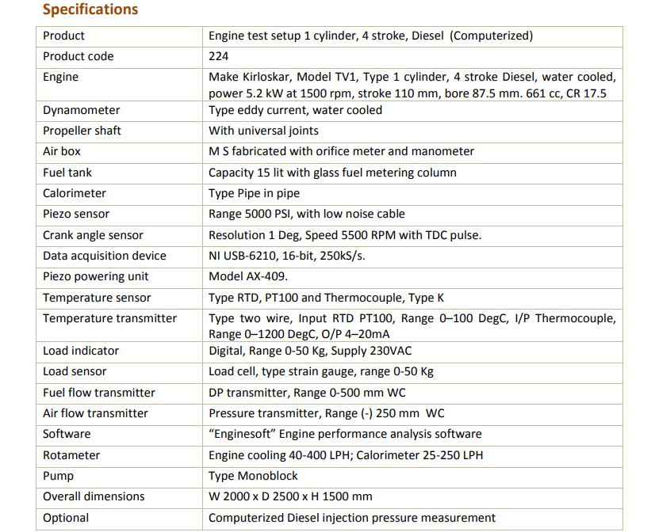
ENGINE SPECIFICATIONS

Slide 14
PREVIOUS WORKS
Various blends of turpentine-diesel blends namely B20,B30,B40,B50 were taken and tested for the performance, combustion and emission characteristics of single cylinder diesel engine.
The brake thermal efficiency was lower for the biodiesel blends when compared with the diesel fuel.
The specific fuel consumptions were found to be increased.
The combustion pressure and the heat release rate were also found to be lower for the biodiesel blends.
The NOx and CO emissions were reduced at lower loads and found to be higher when the load increases.
Also It was found that the blends B20 and B30 were found to promising to have less emissions and higher brake thermal efficiency than the other blends.
So B20 and B30 blends were chosen for the further testings with hydrogen induction.

Slide 15
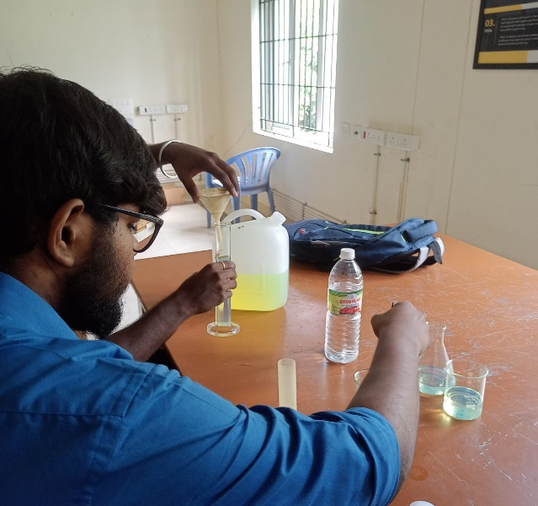
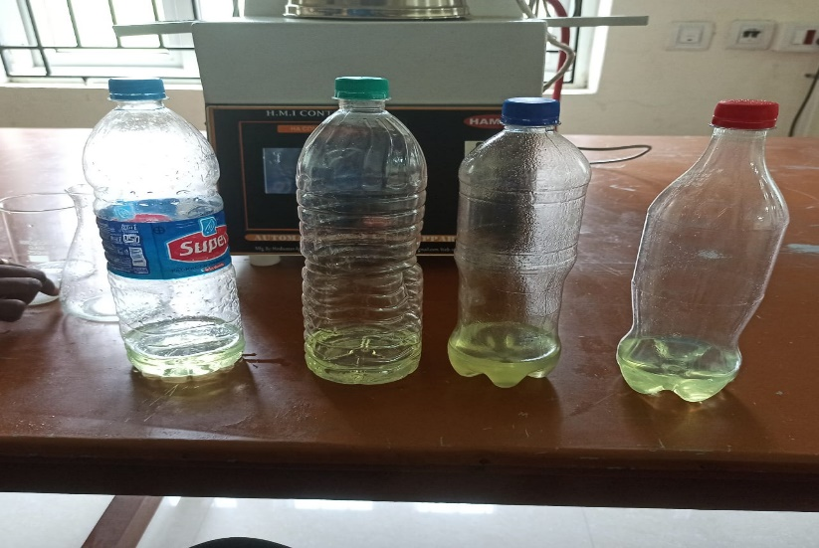
PREPARATION OF BIO-DIESEL BLEND
From the result of phase 1, we choose 2 blends (B20 and B30) from the 4 blends (B20,B30,B40 and B50).
These two blends were taken based on their brake thermal efficiency of 31.92% for B20 blend and 31.71% for B30 blend at full load (100%) when compared to the other blends.

Slide 16
HYDROGEN ENERGY SHARE CALCULATION
BP = T*2ΠN/60000 Kw
BSFC = mass of biodiesel* CV of biodiesel *3600/BP
BSFC(dual fuel) = mass of biodiesel*CV of biodiesel+mass of H₂* CV of H₂ / BP
From this equation we can calculate the mass of biodiesel to be injected. Here from our calculation, the mass of biodiesel is 93%
HES = mass of H₂*CV of H₂ / mass of H₂*CV of H₂ + mass of
biodiesel*CV of biodiesel
From the calculation it is found that the energy share ratio of hydrogen is 30%

Slide 17
HYDROGEN ENERGY SHARE CALCULATION
For B20 blend:
BP = 5.2 Kw
density _{H2} = 0.09 g/L
Volume flow rate of H₂ = 2 lpm
BSFC = m_{d} * CV_{d} *3600 / BP
= 11.76
mass of biodiesel = 0.93
= 93%
HES = m_{H2} * CV_{H2} / m_{H2} * CV_{H2} + m_{d} * CV_{d}
= 0.30
= 30%

Slide 18
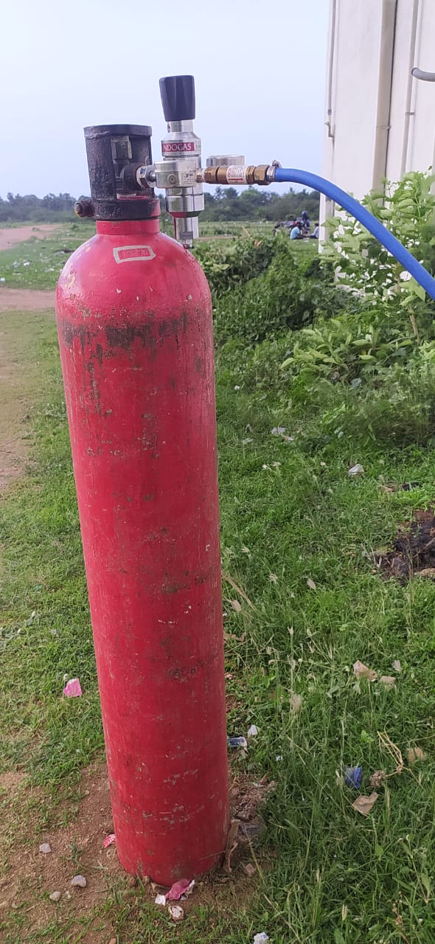
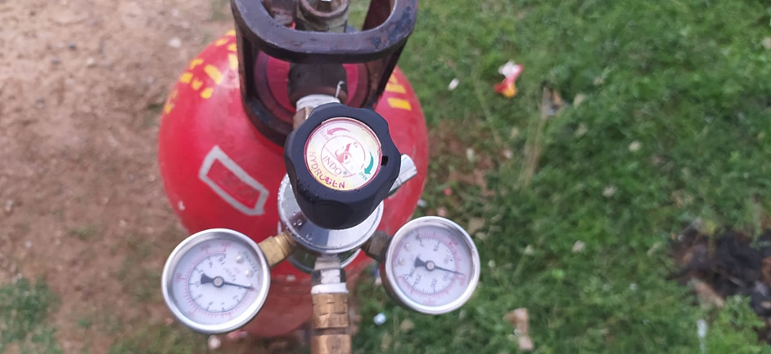
INSTALLATION OF HYDROGEN INDUCTION SETUP
HYDROGEN CYLINDER:
Hydrogen is stored in a
Metallic cylinder in a
compressed Gaseous state.
Hydrogen was stored
Under the pressure of 260
bar for this project.
PRESSURE REGULATOR:
A pressure regulator is a valve that controls the pressure of a fluid or gas to a desired value, using negative feedback of controlled pressure.

Slide 19
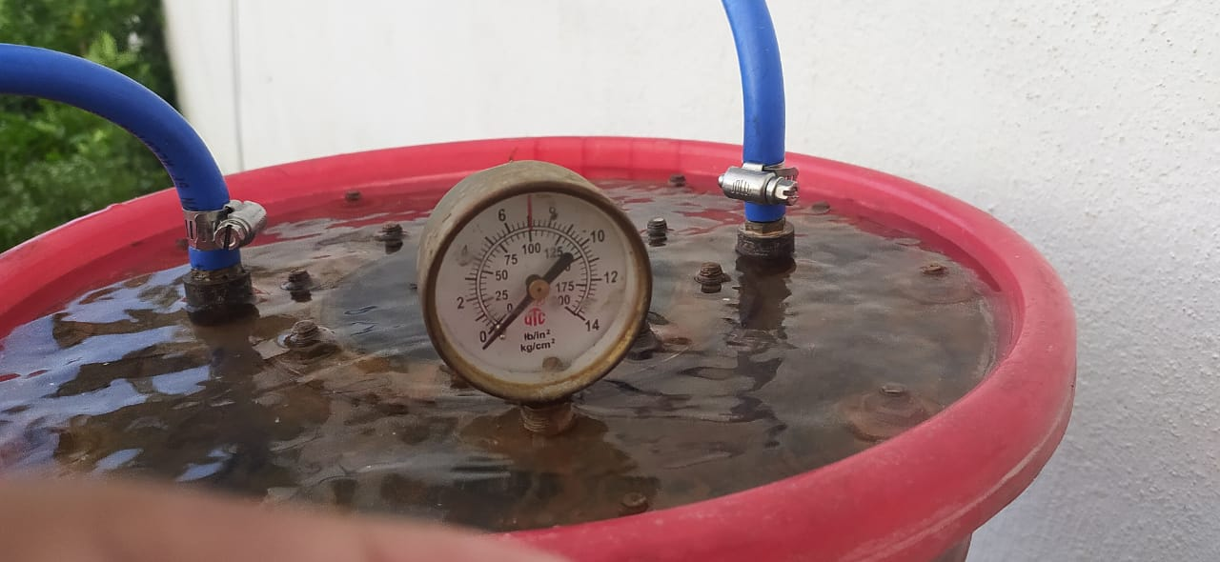
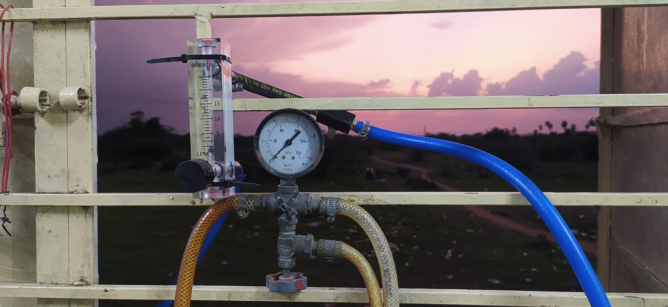
INSTALLATION OF HYDROGEN INDUCTION SETUP
FLAME TRAP:
A flame trap or flame arrestor is used to arrest backfire in H2 supply line which reduces the risk of explosion
FLOW METER:
Flowmeter is connected next to flame trap to measure the flow of hydrogen.it measures the supply of hydrogen gas in litre per minute (LPM)

Slide 20
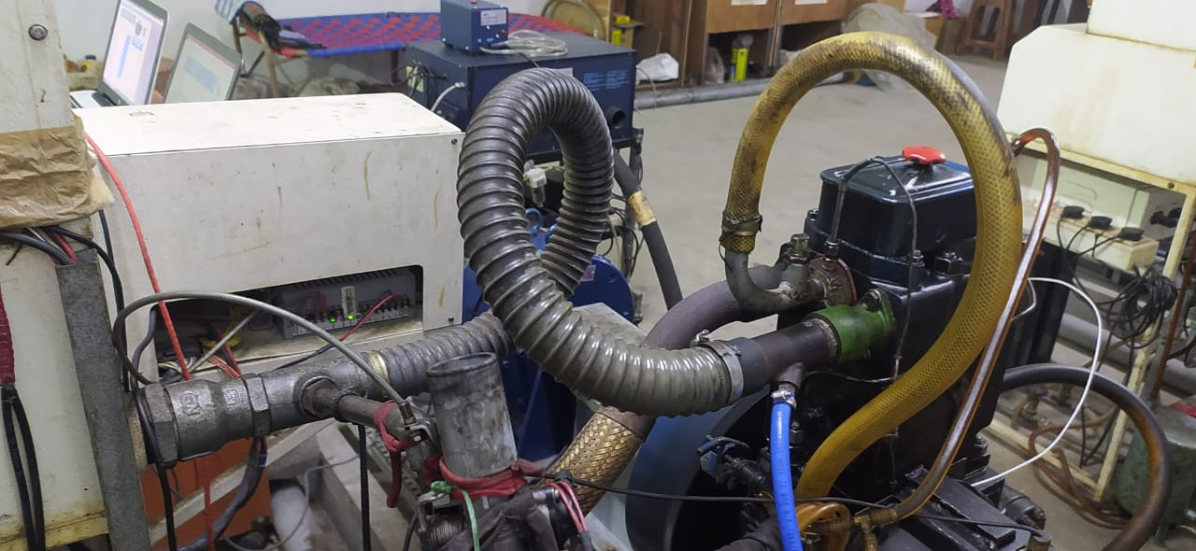
HYDROGEN INDUCTION SETUP

Slide 21
FUTURE WORK PLAN
To run the engine in a dual fuel mode (hydrogen + bio diesel)
To compare the performance , combustion and emission characteristics of hydrogen over biodiesel.
To calculate efficiency and the expected graphs.

Slide 22
THANK YOU

